Slide 1
Document Object Model (DOM)
DOM Structure | Searching the DOM | Modifying DOM Node Attributes | Modifying DOM Node Content
Notes:
Welcome to our lecture on Document Object Model. In this lecture we will go through DOM structure, searching the DOM, modifying DOM node attributes, and modifying DOM node content. Let’s start our lecture.

Slide 2

DOM Structure
The DOM is a tree-like structure of an HTML document, where nodes represent elements, text, and attributes.
The root node is the node at the top of the DOM.
A child node is the node directly under another node. A node can have zero, one, or more child nodes (children).
A parent node is the node directly above another node. All nodes, except the root node, have one parent node.
Notes:
As we explore how web pages are structured let us discuss the Document Object Model or DOM. The DOM is a tree-like structure where each element on the webpage is represented as a node. The root node is at the top while child nodes exist under parent nodes. A parent node connects to its children creating a hierarchical structure. Understanding the DOM is essential for dynamically modifying web content.

Slide 3
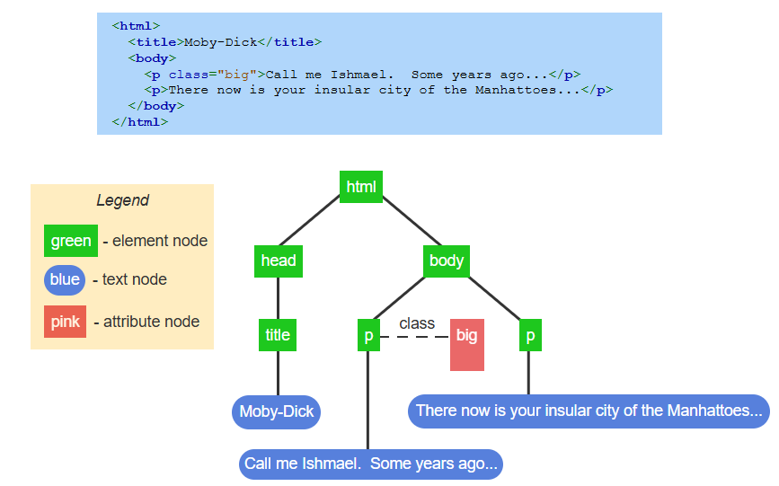
Example
Notes:
Now let us look at an example of the Document Object Model in action. The HTML code defines a simple structure with paragraphs and a title. The DOM represents this as a tree where each element is a node. Green nodes are elements like paragraphs and titles blue nodes are text content and pink nodes are attributes. Understanding this hierarchy helps in manipulating web pages dynamically with JavaScript.

Slide 4
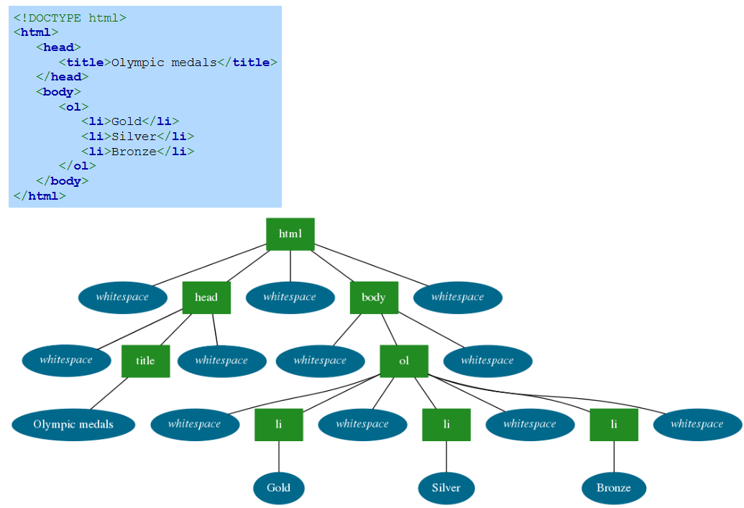
Complete DOM tree visualization with whitespace text nodes.
Notes:
Let us examine a complete DOM tree including whitespace text nodes. The HTML code defines a simple list structure which the DOM represents as a hierarchical tree. Each element such as html head body and list items is a node. Whitespace between elements is also treated as a node. This visualization helps understand how browsers interpret and structure HTML making it easier to manipulate with JavaScript.

Slide 5
Searching DOM
JavaScript searches the DOM to find and modify nodes, like updating content when deleting an email. The document object provides five primary methods that search the DOM for specific nodes:
document.getElementById(id) returns the DOM node with the matching id. Ex: document.getElementById("early_languages") returns a <p> node.
document.getElementsByTagName(tag) returns an array of all matching tag nodes. Ex: document.getElementsByTagName("li") returns all <li> nodes.
Notes:
Now let us explore how JavaScript searches the DOM to find and modify elements. The method getElementById retrieves a single element using its unique id while getElementsByTagName returns an array of all matching tag nodes. These methods are useful for dynamically updating webpage content. Understanding how to search the DOM efficiently is key to effective web development and interactivity.

Slide 6
Searching DOM
document.getElementsByClassName(class) returns an array of nodes with the matching class. Ex: document.getElementsByClassName("traditional") returns matching <ol> nodes.
document.querySelectorAll(selector) returns an array of all nodes matching a CSS selector. Ex: document.querySelectorAll("li a") returns all <a> inside <li>.
document.querySelector(selector) returns the first matching node. Ex: document.querySelector("li") returns the first <li>.
Notes:
Continuing with DOM searching let us look at additional methods. The getElementsByClassName method retrieves elements with a specific class while querySelectorAll selects all elements matching a CSS selector. The querySelector method returns only the first matching element. These methods provide flexible ways to access and manipulate webpage elements efficiently using JavaScript.

Slide 7
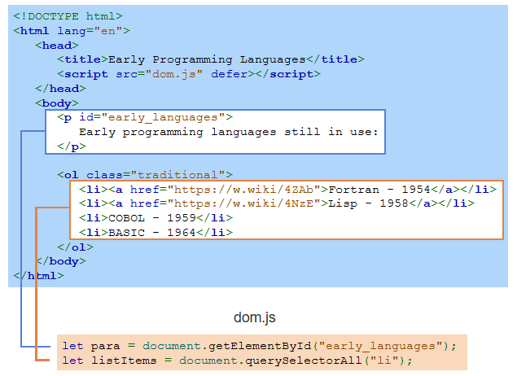
Example
Notes:
Now let us see an example of searching the DOM. The HTML file contains a paragraph with an id and a list with multiple items. The JavaScript file uses getElementById to find the paragraph and querySelectorAll to select all list items. This demonstrates how JavaScript can locate specific elements within a webpage structure allowing for dynamic content updates and interactive features.

Slide 8
Modifying DOM node attributes
After finding a DOM element, JavaScript can examine or modify its attributes to:
Change which image is displayed by modifying an img element's src attribute.
Determine which image is currently displayed by reading the img element's src attribute.
Change an element's CSS styling by modifying an element's style attribute.
Notes:
Now let us explore how JavaScript modifies DOM node attributes. After selecting an element we can change which image is displayed by updating the src attribute of an img tag. We can also read the current image source to track changes. Additionally we can modify an element's CSS by updating its style attribute. These techniques allow dynamic customization of webpage content and appearance.

Slide 9
Modifying DOM node attributes
Each HTML attribute has a matching DOM property, acting as both a getter and setter. Ex: <a href="https://www.nasa.gov/" id="nasa_link"> has href and id properties.
Getter: Reads an attribute's value. Ex: nasaUrl = document.getElementById("nasa_link").href gets "https://www.nasa.gov/".
Setter: Modifies an attribute's value. Ex: document.getElementById("nasa_link").href = "https://www.spacex.com/".
Notes:
Now let us see how JavaScript interacts with HTML attributes using getters and setters. Each attribute has a matching DOM property. A getter retrieves an attribute’s value such as reading an HREF link. A setter modifies an attribute’s value allowing us to update links or other attributes dynamically. These methods provide an easy way to manipulate webpage elements using JavaScript.

Slide 10
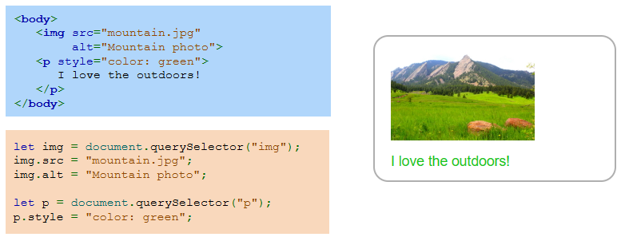
Example
Notes:
Now let us look at an example of modifying DOM attributes with JavaScript. The HTML includes an image and a paragraph with inline styling. The JavaScript code selects the image and paragraph using querySelector then updates the image source and alternative text while changing the paragraph color. This demonstrates how JavaScript dynamically modifies elements making web pages more interactive and customizable.

Slide 11
Modifying DOM node content
After finding a DOM element, JavaScript can examine or modify its content.
Two common properties for this are:
textContent gets/sets a node's text. Ex: document.querySelector("p").textContent = "$25.99"; → <p>$25.99</p>
innerHTML gets/sets a node's HTML content. Ex: document.querySelector("p").innerHTML = "<strong>$25.99</strong>"; → <p><strong>$25.99</strong></p>
Notes:
Now let us explore how JavaScript modifies DOM content. The text Content property sets or retrieves the text inside an element while inner HTML allows updating HTML content including tags. For example, we can change a paragraph's text or format it with bold styling. These properties help dynamically update webpage content making it more interactive and customizable based on user actions.

Slide 12
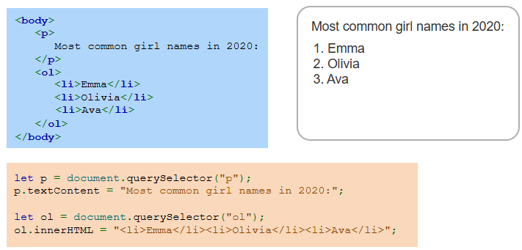
Example
Notes:
Now let us see an example of modifying DOM content using JavaScript. The HTML contains a paragraph and an ordered list. The JavaScript code selects the paragraph and updates its text using text Content while inner HTML modifies the list items dynamically. This approach allows us to change webpage content on the fly making it more interactive and adaptable to user inputs or data updates. Thanks for watching the lecture.

